Slide 1
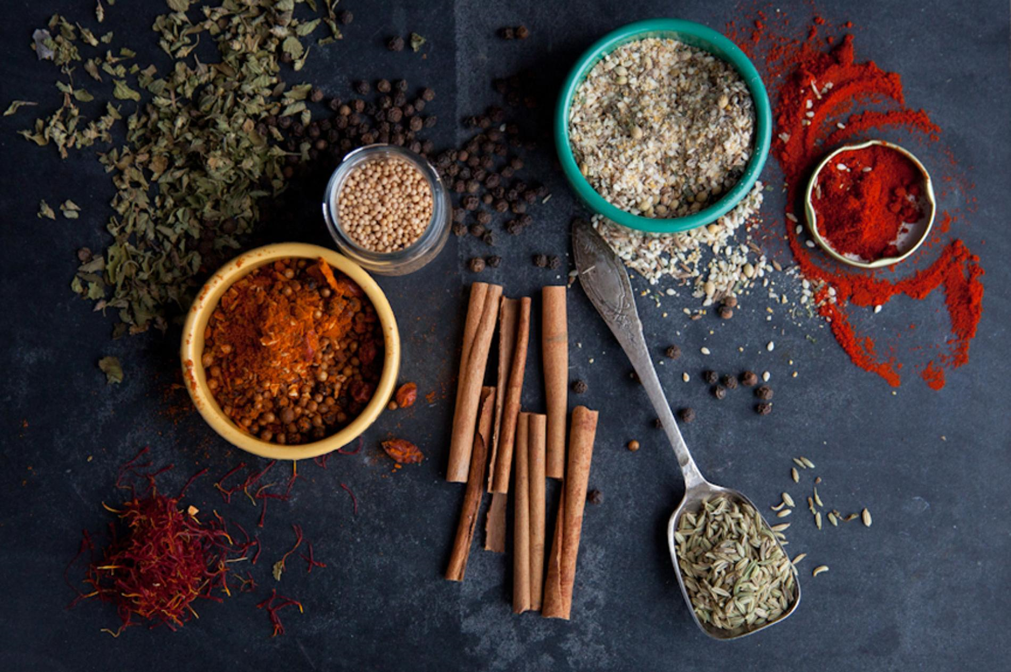
TEAM 01 NOV 16

Slide 2
KAO-PIO RESTAURANT
WEBSITE
www.kaopio.com.au
Website for an upcoming restaurant located in Brisbane
Order food with KAO PIO’s online order services.

Slide 3
TEAM
NAME : TEAM01NOV16
MEMBERS: ABHISHIKTH KALLURU
AVINASH RAJEEV
GITHIN SHAJI
RAVI TEJA KAMBALA

Slide 4
OBJECTIVES
To provide fresh and delicious food instantly at best price.
Additional feature of free home delivery.
To develop user friendly website for online food ordering/take away that is time saving for customers.
Compatible website for all devices.
Customers can choose from wide ranges of cuisines.
Offers delicious Combos and Deals of the day that never run out of variety and get updated everyday.
Quick searching your favourite food.

Slide 5
TARGET USERS
Primary users
We are targeting every food lover who have an access to internet
and those who like to try different cuisines just a click away.
Secondary users
Database Administrator

Slide 6
PLANNING
Features:
Online food ordering made easy with one click
Users will have an option to see the recipes of each dish.
Special privilege to customize the recipe.
Responsive web pages will fit into wide range of devices.
Instant deals and special offers

Slide 7
Project Planning
Technologies In Use
Front end requirements: HTML5,CSS,JAVASCRIPT.
Back end requirements: PHP.
Tools: Dreamweaver,Photoshop,oracle.
Data Requirements:
Customer info for order and home delivery.

Slide 8
Kao-Pio
Search Button
Recipes
Take Away
Menu
Submit page
Home Delivery
Offers
Combos
Home
Deals Of the Day
About Us
Social Media Links
Notes:
Home
Recipes
Menu
Offers
About Us
Social Media Links
Search Button
Take Away
Home Delivery
Combos
Deals Of the Day
Submit page

Slide 9
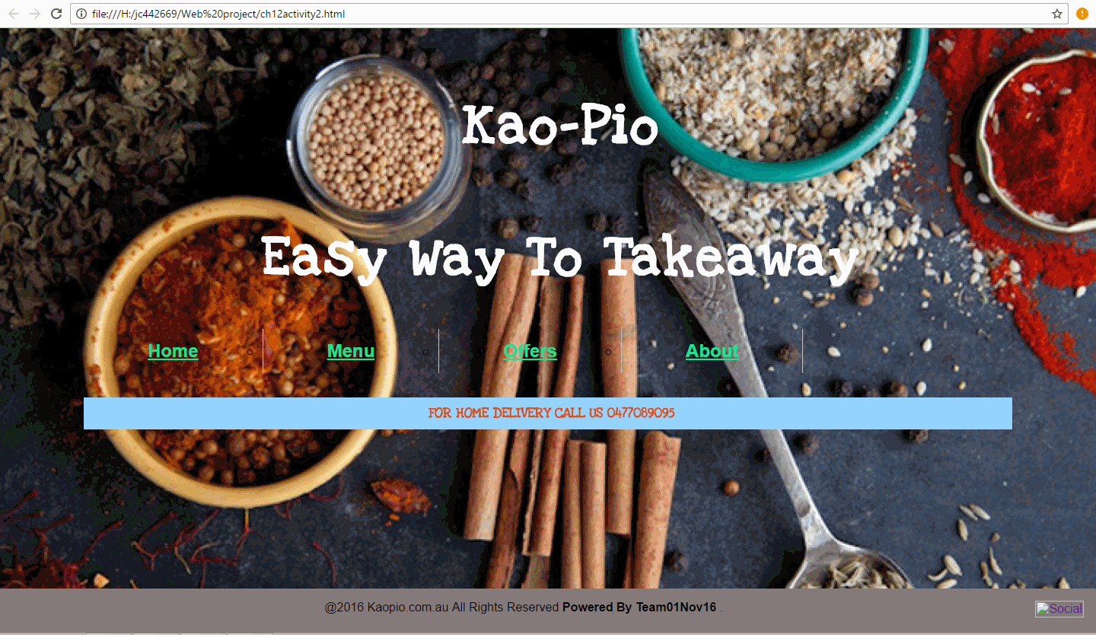

Slide 10
Team Responsibilities & Project Milestone
Development and designing of
Home page & About us page with Data collection. : Githin
Offers, Deals and Documentation : Avinash Rajeev
Home delivery ,Search Button and Recipes : Abhishikth
Menu page and Take away : Ravi
Schedule:
Week 6: Blue print & Website Visual Design layout.
Week 7:Designing of all the following pages and assembling their database .
Week 8:Linking the Home, Menu and Offers page to the following subset web pages.
Week 9: Final Website.

